Slide 1
FUZZY CONTROL

Slide 2
Contents -
Introduction
Why fuzzy control?
Fuzzy sets and logic, and linguistic variables
Fuzzy Control
Definition
Design Scheme
Structure
Implementation in MATLAB
Structure
Types
Comparison via Simulink, conventional PID vs Fuzzy controller
Various control strategies

Slide 3

Fuzzy versus conventional approach towards control

Slide 4
Advantages of Fuzzy Controllers
Easy to understand - since rules of governing the control law are expressed in natural linguistic terms.
Customizable
Robust – can cover a wide range of operating conditions and can operate with noise and disturbances
Cheaper

Slide 5
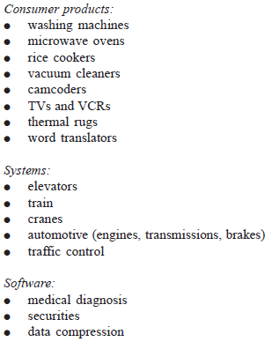
Fuzzy controller applications

Slide 6
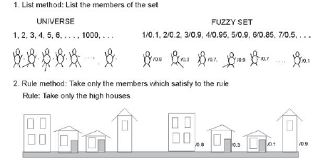

CRISP SET | FUZZY SET
To specify the elements of a crisp set we use two methods, List method – we list all the numbers of the set, Rule method - we specify a criterion(or a discriminating function as given in equation given below) for an element to belong to a particular set | If we replace the discrete valued discrimination function with a continuous function which can attain values from [0,1], we get a membership function which specifies the degree to which a element belongs to the given fuzzy set.
Eg, A is a set of all natural numbers greater then three, Universal set – all natural numbers, and A = {4,5,6,……..} | A fuzzy set is a set of ordered pairs, from universal set containing elements and their membership degrees.

Slide 7
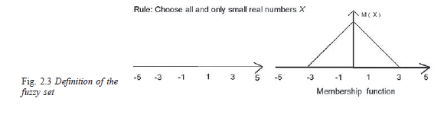
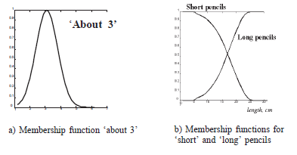
Some terms related to fuzzy sets
Membership function – A function which describes the degree to which an element belongs to the given set( say A), from a universal set.
For eg -
Support – The support S(A), of a fuzzy set A is the crisp set of all the elements of the universal set which have a membership degree > 0.
Membership function in case support is infinite,
Cross-over point – The element of the universal set, for which the membership function has the value of 0.5, is called the crossover point.

Slide 8
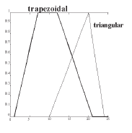
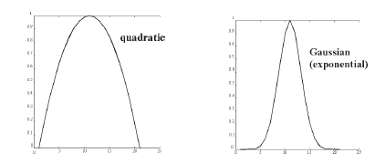
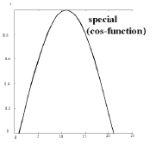
Types of membership functions -
Piecewise linear
Triangular
Quadratic
Some other special functions : cosine and sine.
Trapezoidal
Gaussian -

Slide 9
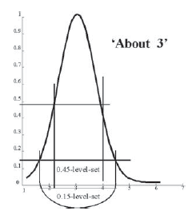
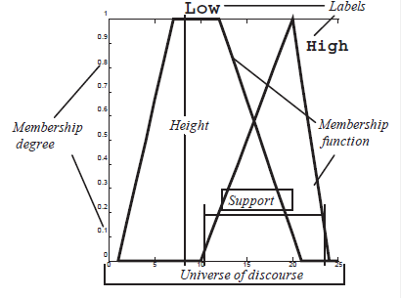
Level set – The set of elements that belong to the given fuzzy set at least to the degree alpha is called the alpha-level-set or alpha-cut-set
For eg -
Height of a fuzzy set - It is equal to the supremum of the membership function over all of the elements of universal set, where Supremum == highest possible or almost possible degree.
Height of a fuzzy set A =

Slide 10
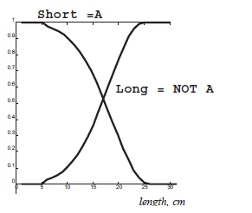

Operations on fuzzy sets
Complement - Complement of a fuzzy set A has a membership function which is pointwise defined for all
Intersection -
Where
is triangular norm, defined as

Slide 11


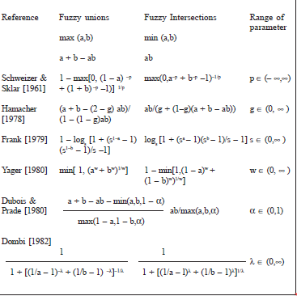
Union –
Some methods of calculating intersection and unions –

Slide 12

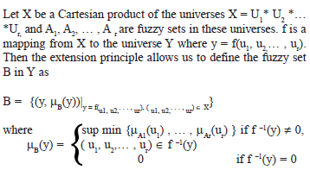

Extension principle 1 – In case of Single output single input function - SISO function
If A is a fuzzy set in the universe U and f is a mapping from universe U to universe Y, such that y = f(u), then extension principle allows us to define a fuzzy set B in universe Y such that
Here we use supremum function since f may map different elements of u into same one element of the universe Y, thus this element in universe Y may have more than one membership degrees, so to define uniquely the membership degrees of elements in Y we choose the highest one.
For eg. – A = { -2/0.3, -1/0.4, 0/0.8, 1/1, 2/0.7 }, y = f(u) = u^2; then
B = { 4/0.3, 1/0.4, 0/0.8, 1/1, 4/0.7} = { 0/0.8, 1/1, 4/0.7 }
Extension principle 2 – In case of a system with multiple inputs and output –
for eg let y = u1+u2, then

Slide 13

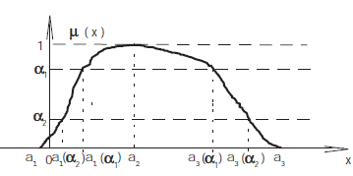
Fuzzy numbers
If the support of the membership function is a part of the real axis, the fuzzy set represents a fuzzy number if the membership function is normal and convex.
Normal fuzzy set – The fuzzy set is normal if
Convex Fuzzy set –
Convex means that any alpha-cut which is parallel to the horizontal axis
Yields the property of nesting, that is if
Or if we represent the alpha-cut by interval A_alpha, then

Slide 14



Arithmetic operations with intervals of confidence
Addition and subtraction -
Multiplication -
Inverse –
Division –
In case of positive operands –

Slide 15
Arithmetic operations with Fuzzy numbers

